Slide 1


Slide 2

DEVELOPMENT
Digital Design Tape-Out IC process

Slide 3

Agenda
Specification
RTL Design
Functional Simulation
Synthesis
Physical Design
Sign-off Verification
GDSII/OASIS Generation

Slide 4

Overview
The digital IC design process transforms functional specifications into digital building blocks, which are subsequently mapped into logic circuits.
A significant portion of the design constraints arises from foundry requirements and the limitations of current semiconductor technologies.

Slide 5
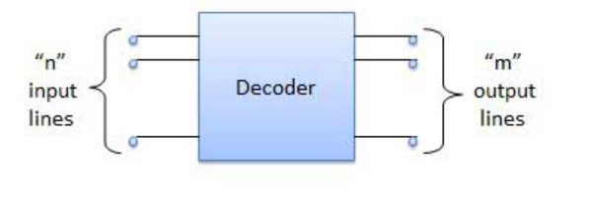
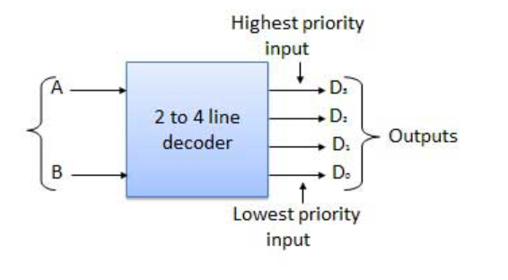
1. Specification
Define functionality, performance, power, area, and cost targets.
Input/Output interfaces and protocols are specified.
Example: What should the chip do? (e.g., multiplexer, decoder, encryption engine, etc.)

Slide 6
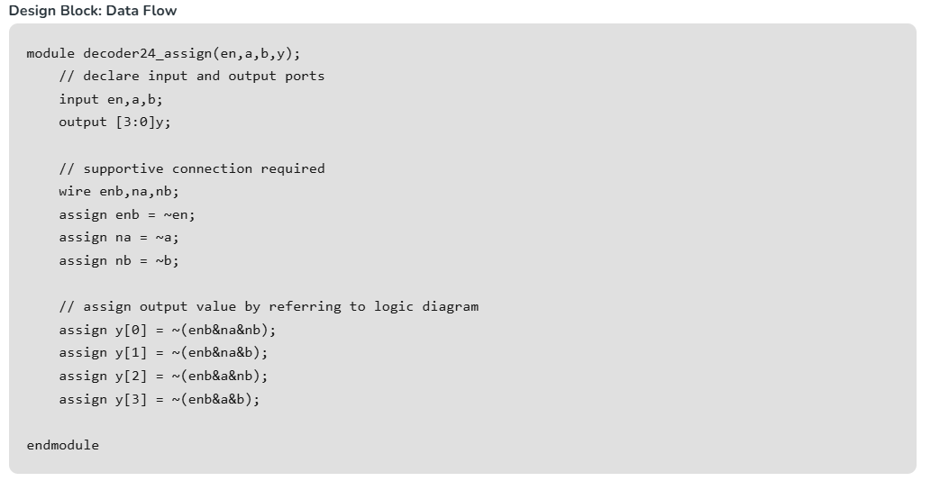
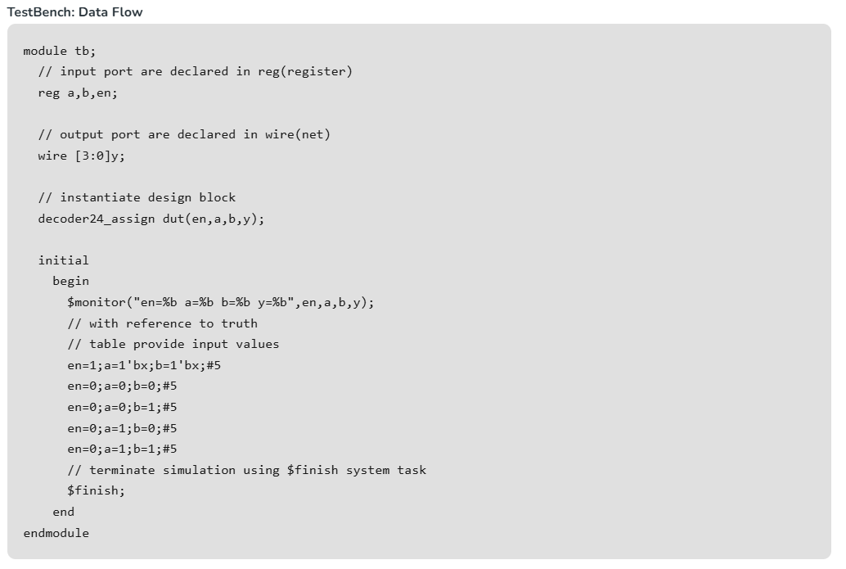
2. RTL Design
Design is written in HDLs like Verilog or VHDL.
Behavioral and structural models are created.
Focus on modularity, synchronous design, and reuse.

Slide 7
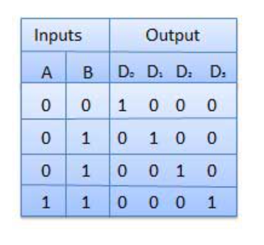
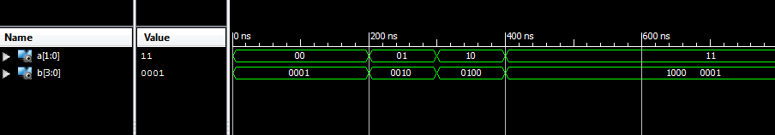
3. Functional Simulation
Simulate RTL using testbenches to verify logic correctness.
Tools: ModelSim, VCS, QuestaSim.
Catch logical bugs before synthesis.

Slide 8
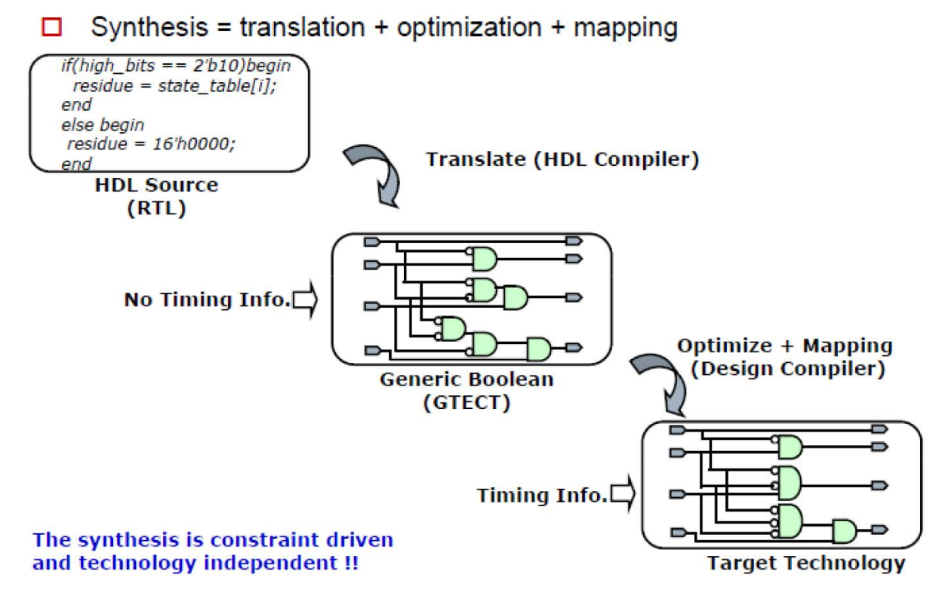
4. Synthesis
Convert RTL (HDL) to a gate-level netlist using a standard cell library.
Tool: Synopsys Design Compiler, Cadence Genus.
Optimize for timing, area, and power.
Constraints (SDC) are applied here.

Slide 9
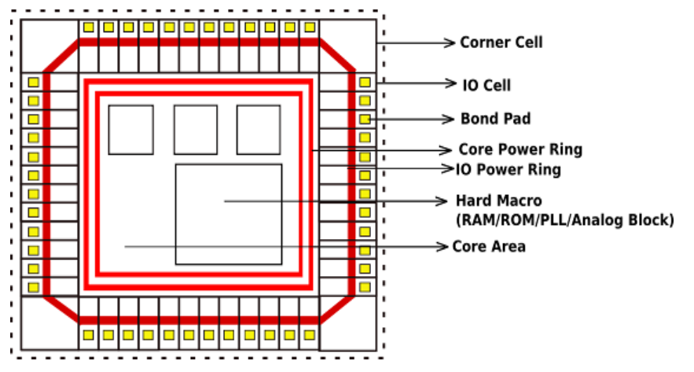
5. Physical Design
Floorplanning: Define chip area and block placement.
Placement: Place standard cells.
Clock Tree Synthesis (CTS): Distribute the clock signal efficiently.
Routing: Connect all logic gates and components.
DRC & LVS: Check for design rule violations and ensure schematic/layout consistency.

Slide 10
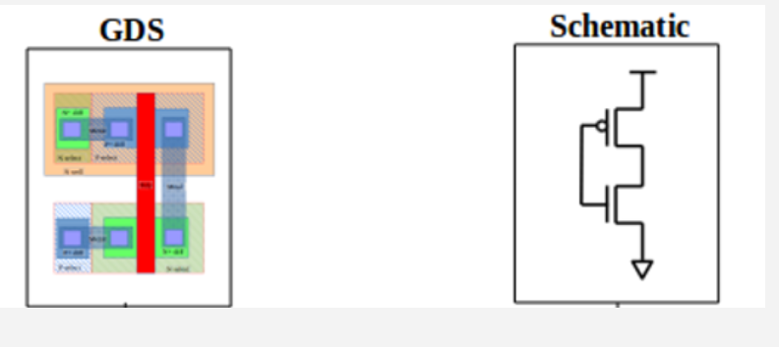
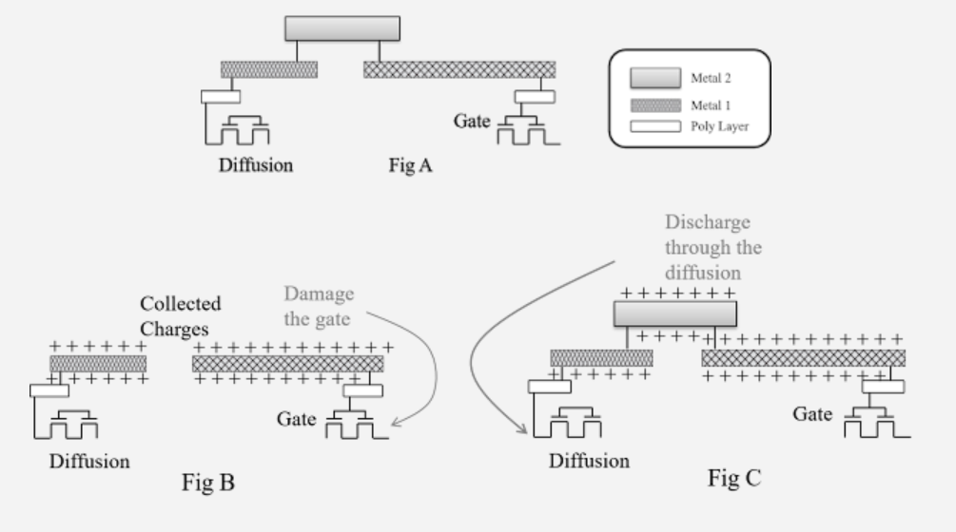
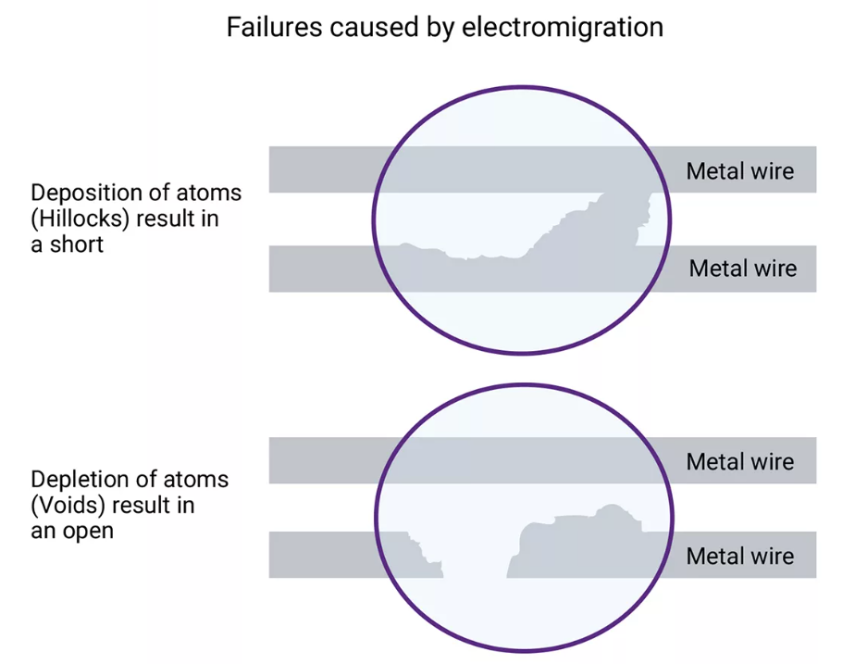
6. Sign-off Verification
Before tape-out, several critical checks are done:
Timing Sign-off (STA – Static Timing Analysis)
Power Analysis
Electromigration & IR Drop (EM/IR)
Formal Verification
DRC/LVS Sign-off

Slide 11
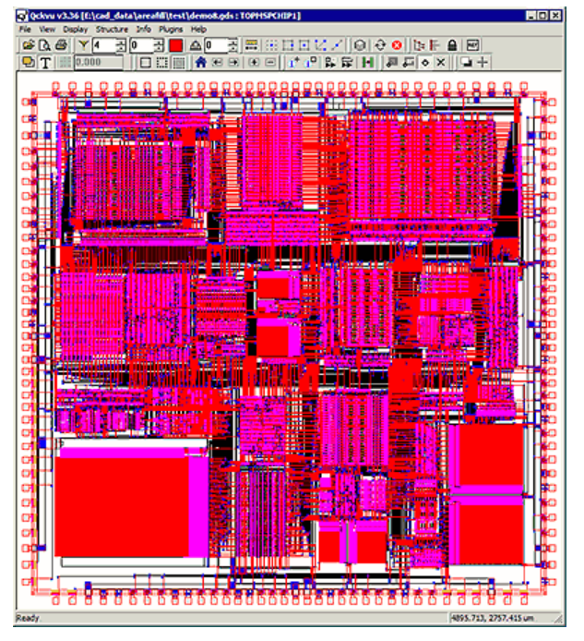
7. GDSII/OASIS Generation
The design is converted into a GDSII or OASIS file — the formats used by foundries.
This file contains all physical layout information: polygons, layers, vias, etc.
Sent to the foundry for mask generation and chip fabrication.

Slide 12
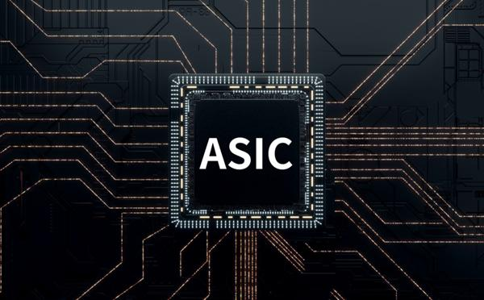
8. Silicon Validation
Once the chip returns from the fab, it's tested in lab environments.
Test vectors, scan chains, and logic analyzers used to verify functionality.

Slide 13



